Slide 1
Flow chart for development of Test Taker authentication
Akash Singh Rishikesh Bachhav Sahil Rahate​

Slide 2
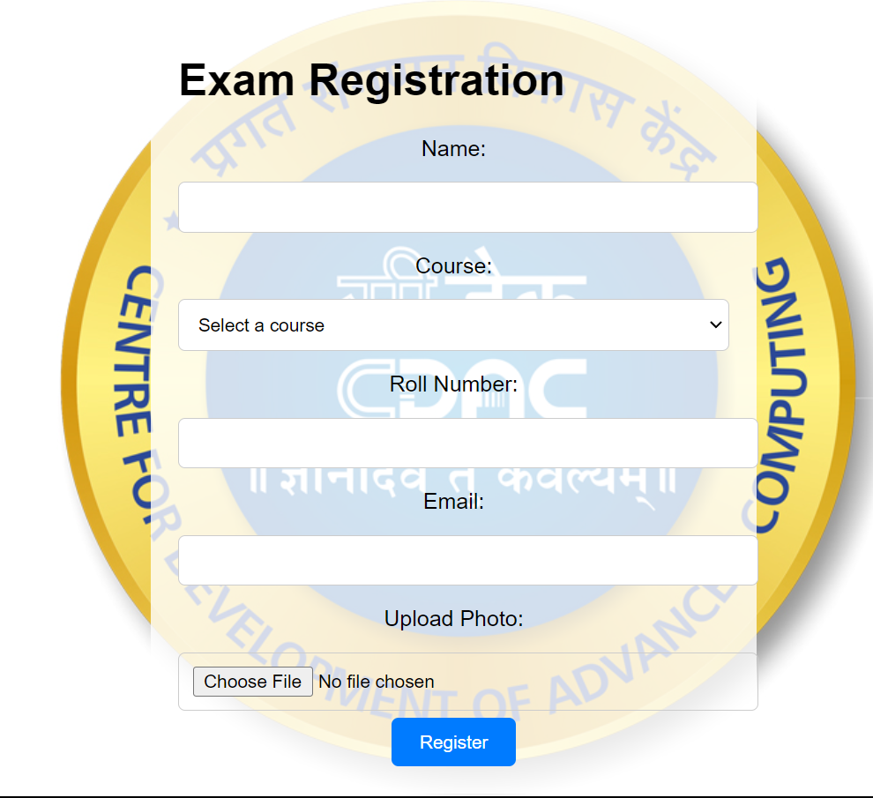
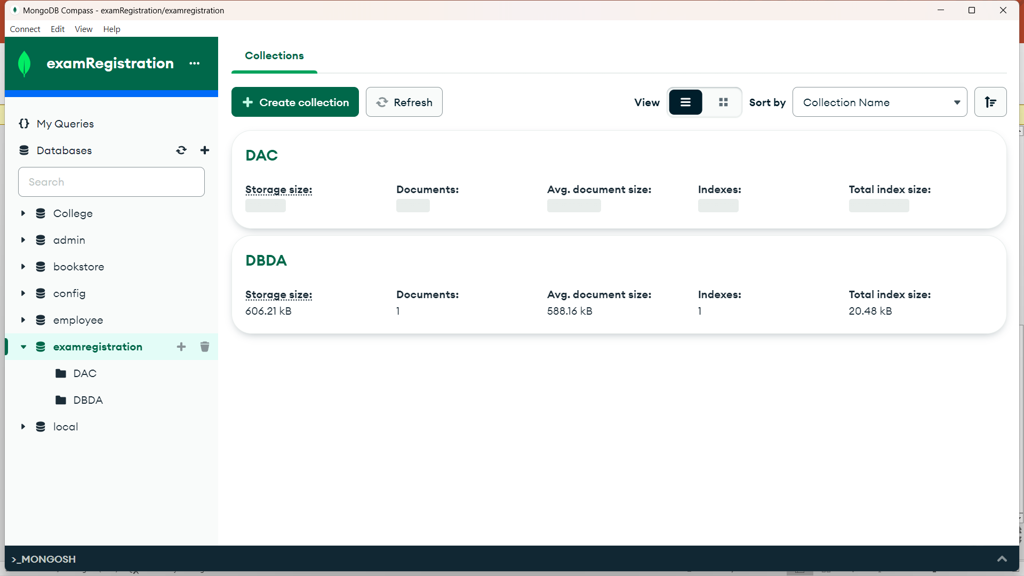
Registers for exam
Data storage
USER
+
Returns user-id and password to the user to registered mail id.
SMTP server & DNS server
Step I – Test Taker Registration

Slide 3
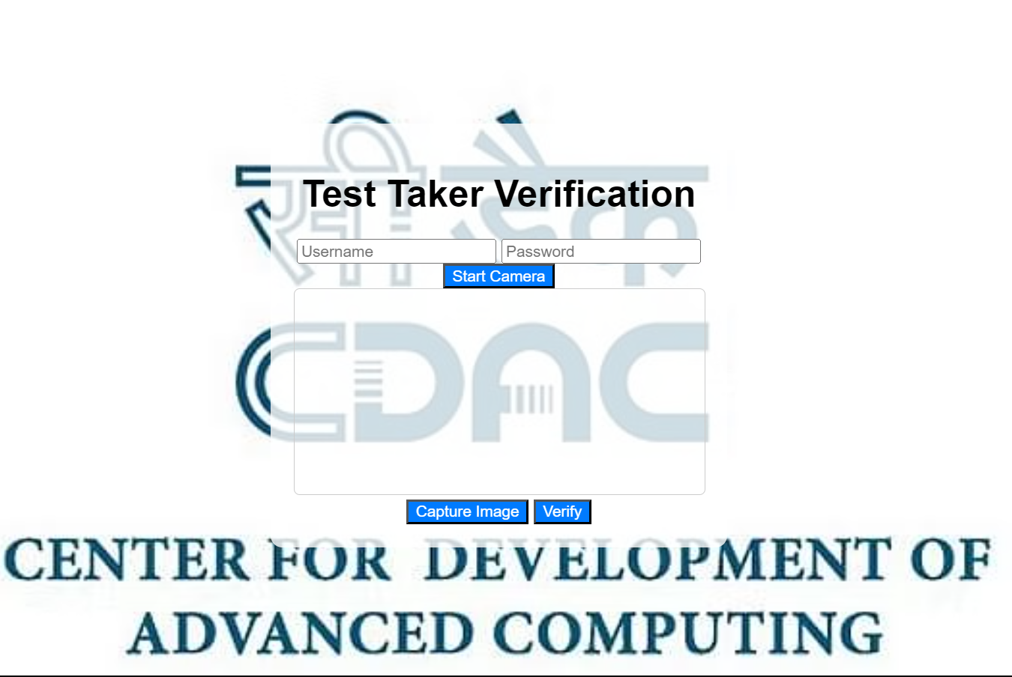
Face recognition model (OpenCV)
User
Inputs user-id
and password
Verifies
Captures real-time photos
Known faces: Authorized
Unknown faces: Unauthorized

Slide 4
Leads to Test Page
Logins into test
using received user-id, password & facial recognition
Authenticated
USER
Error Unauthorized user
Unauthenticated
Step II – Test Taker Authentication

